Slide 1

GOOGLE
STOCK PRICE
PREDICTION
By..
S.GIRI PRASATH
This Photo by Unknown Author is licensed under CC BY-SA

Slide 2

Past 10 years of stock price predicted the future 30 days of stock price using
LSTM.
This Photo by Unknown Author is licensed under CC BY-ND

Slide 3

BACKGROUND
Import the Google stock price dataset of past 10 years.
Preprocess -train and test data.
Create a stacked LSTM model.
Predict the test data and plot the output.
Predict the future 30 days and plot the output.
This Photo by Unknown Author is licensed under CC BY-ND

Slide 4

What I did?
Model is build using LSTM
Trained the model with the previous stock price dataset.
Plotted the future 30 days stock price.

Slide 5

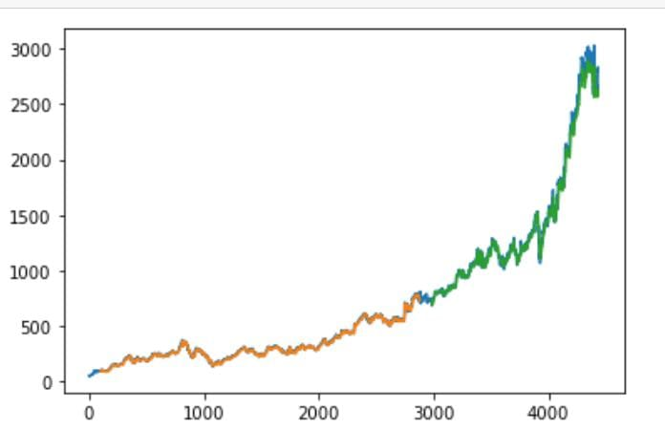
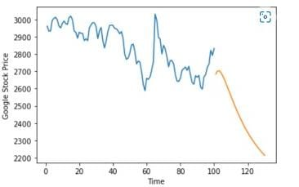
Sample Plots

Slide 6

Conclusion
Model Builded using LSTM.
Data passed into the model.
Prediction is done with past years stock price dataset.
This Photo by Unknown Author is licensed under CC BY-ND

Slide 7




THANK YOU

